Slide 1




Natural solutions to the climate and biodiversity crises in our forests
Prof. Christian Messier, ing. f., Université du Québec à Montréal (UQAM) et (UQO), Chaire du Canada sur la résilience des forêts face aux changements globaux et Chaire HQ sur le contrôle de la croissance des arbres

Slide 2
Presentation Plan
  Forestry and its ghosts
  The threatened forest
  Some interesting new concepts
  For a forestry of resilience

Slide 3
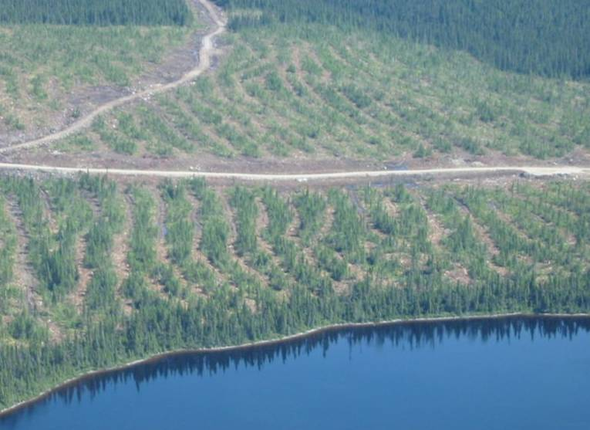
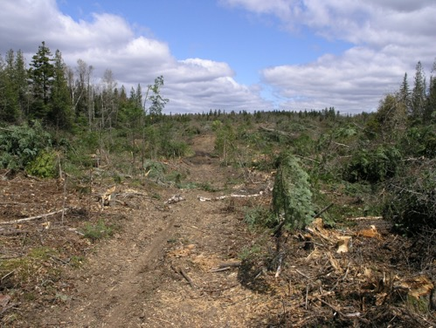
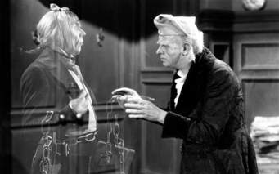
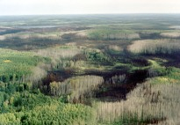
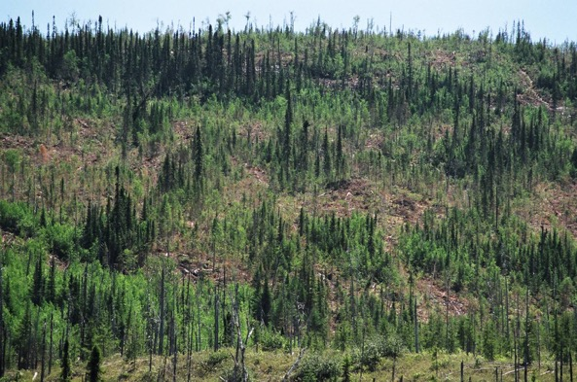
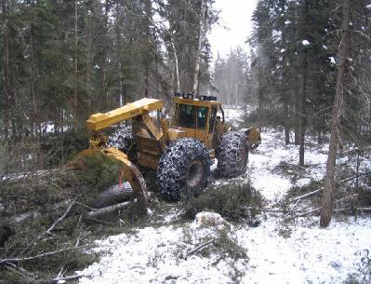

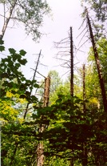
Cutting with regeneration protection
Forest management in Quebec today
Cutting with retention
Partial cut

Slide 4
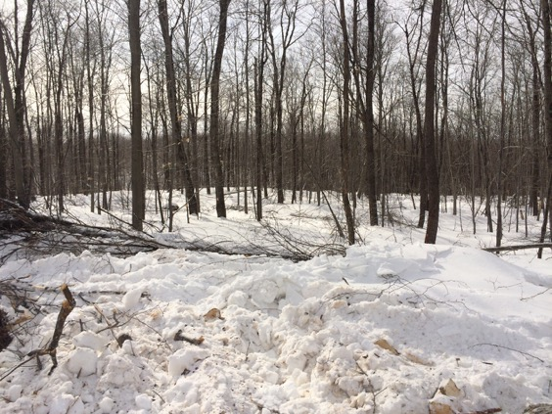
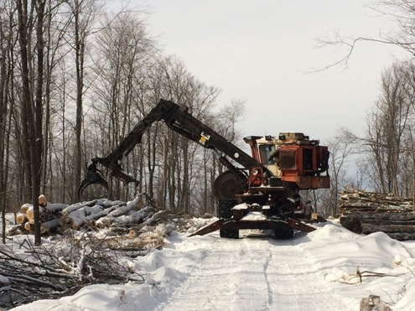
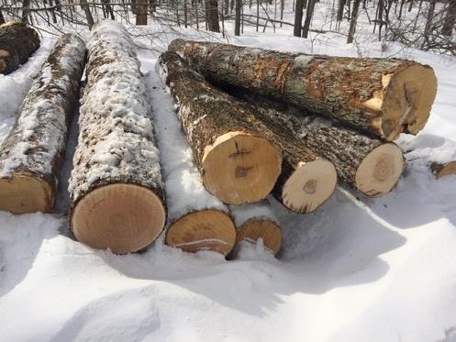
Gardening cut

Slide 5
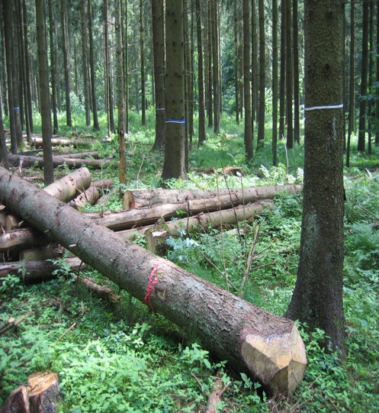
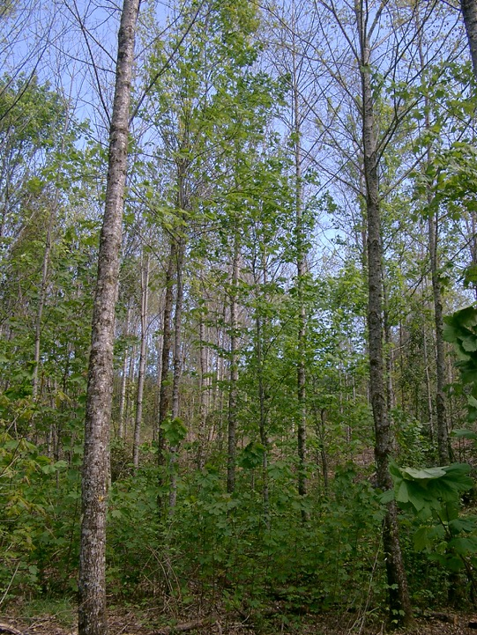
Monospecific plantations

Slide 6
  Forestry has always aimed to simplify the forest to maximize certain services. Is this still the right approach?

Slide 7
Presentation Plan
  Forestry and its ghosts
  The threatened forest
  Some interesting new concepts
  For a forestry of resilience

Slide 8
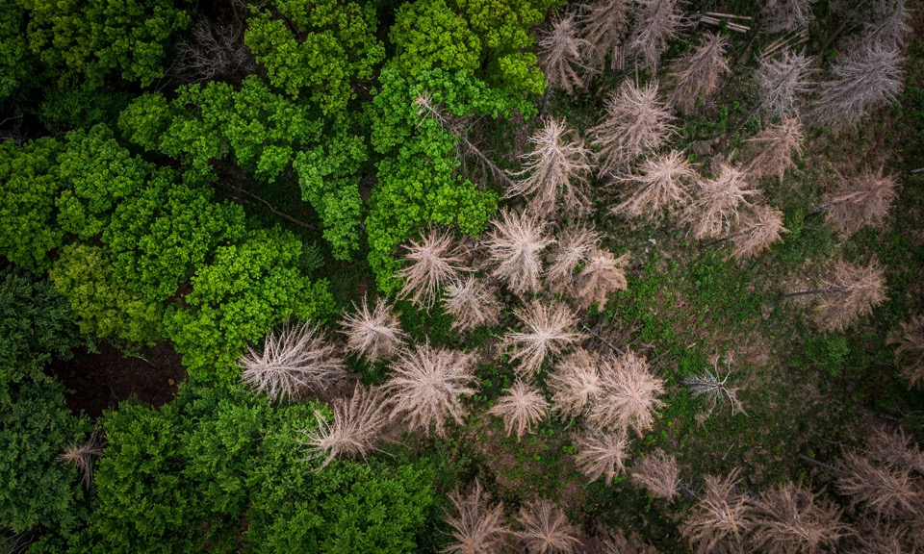
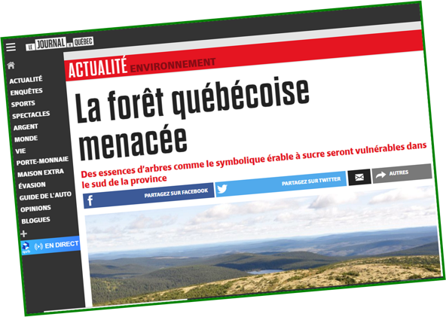
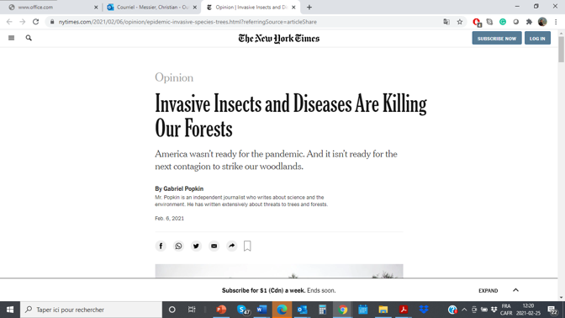
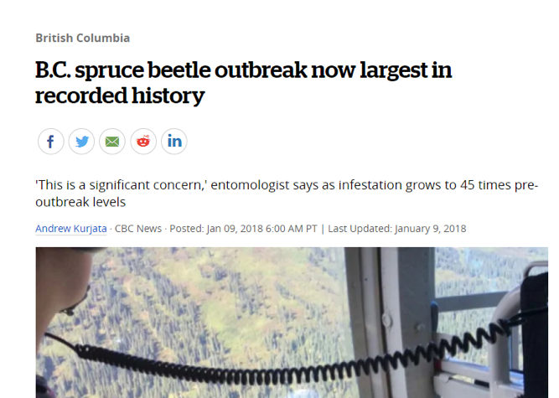
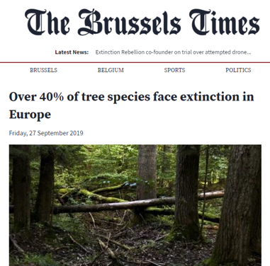
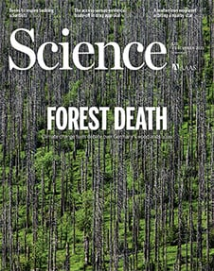
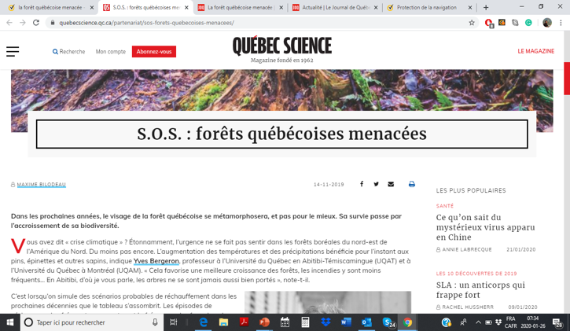
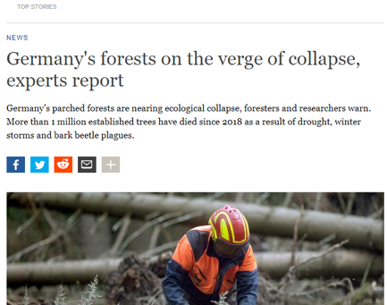
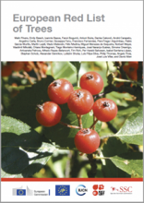
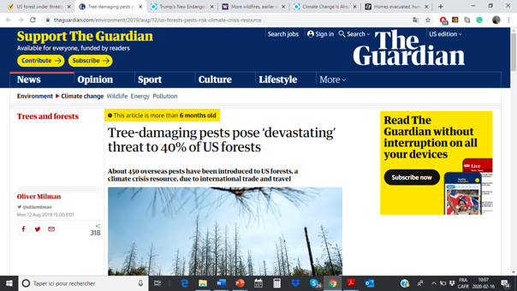

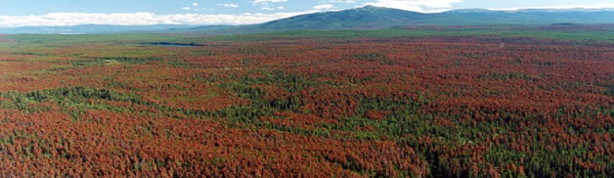
  The threatened forest
IUCN Publication
December 2021
IUCN Publication

Slide 9
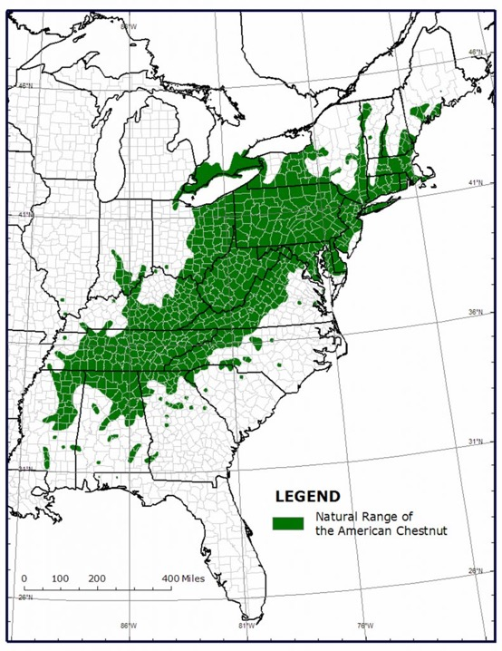
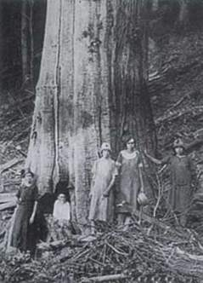
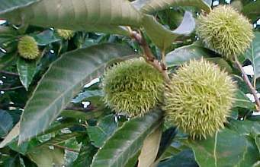
The disappearance of the chestnut (Castanea dentata) by a fungus from Asia that appeared in 1904

Slide 10
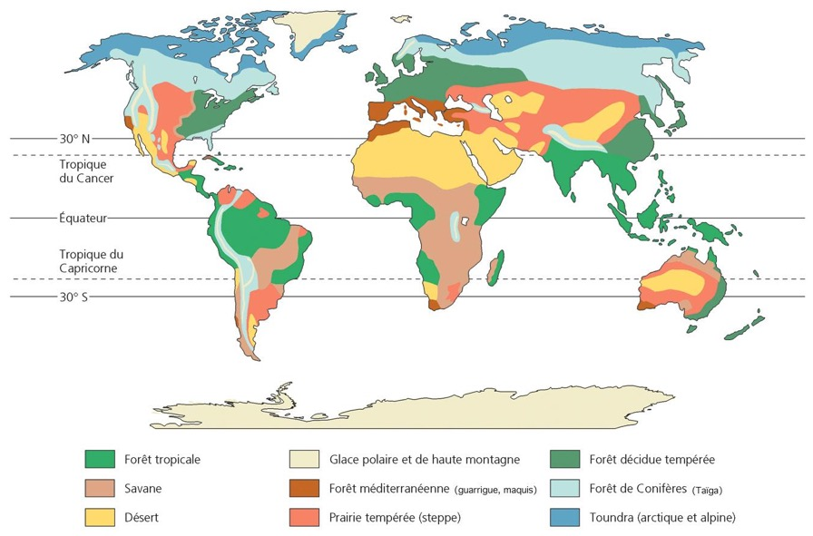
The threat of exotic insects and diseases
Est du Canada
More than 25 exotic insects and diseases are present and may strongly affect more than 30 tree species in Quebec in the next 50 years

Slide 11
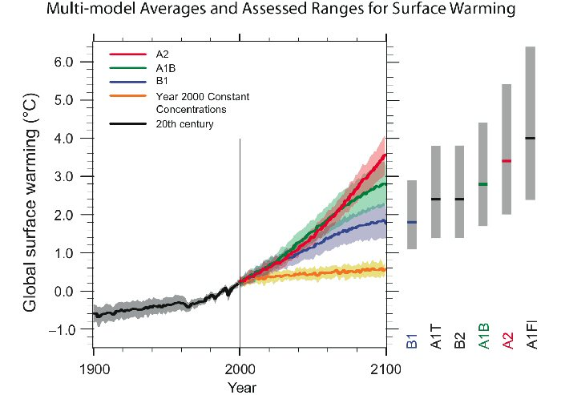
Global warming
}

Slide 12
Tree mortality rates have been increasing EVERYWHERE in Canada and for ALL species since the 1970s and 1980s

Slide 19
Loss of species
Fig. 2. Global forest risk estimates from climate envelope approaches. (C) Risk of loss in species richness [quantified as an effect size (ES) of –1 × log(DSpeciesRichnesshighcc-mitigation/ DSRbaseline)] where higher numbers indicate more risk of species loss) in the 2070s in a high climate change (RCP 8.5) scenario from Mori et al. 2021 (21).

Slide 20
Climate Risks

Slide 21
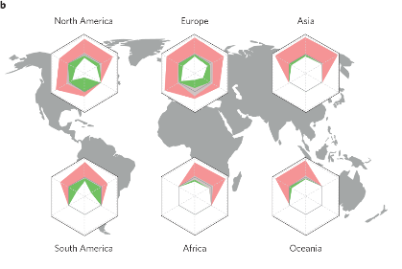
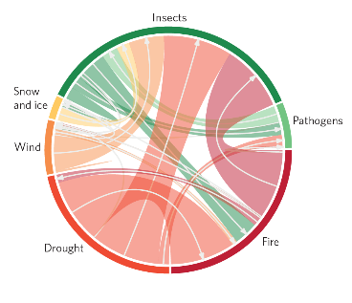
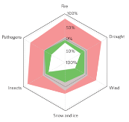
Intensification of forest disturbances and interactions with climate change
Feux
Sécheresse
Pathogènes
Insectes
"We conclude that ecosystems and society must be prepared for an INCREASINGLY PERTURBED future for forests."
Seidl et al. 2018 Nat Clim Change
Seidl et al. 2018. Nat. Clim. Change

Slide 22
  We are entering a period of "high turbulence and uncertainty”. Are there any solutions?

Slide 23
Presentation Plan
  Forestry and its ghosts
  The threatened forest
  Some interesting new concepts
  For a forestry of resilience

Slide 24
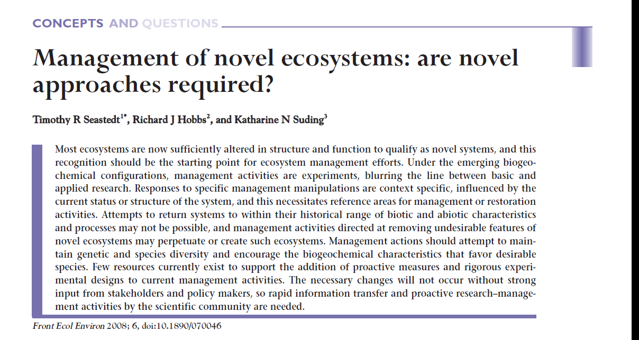
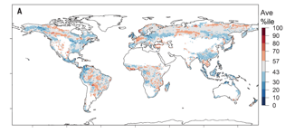
Concept of a new ecosystem
Today and future
Novel ecosystem
In the past
We should not base our forestry interventions only on our knowledge of the past, but ALSO on the changing and uncertain future conditions.
Seastedt et al. 2008
Notes:
24
Figure 2. Creation of novel ecosystems via biotic or abiotic change (modified from
Suding et al. 2004). The “range of variability”, as discussed by Landes et al. (1999),
and the adaptive four-phase cycle of Holling (2001) of a natural ecosystem are
collapsed into the range of values found in zone A. (a) An ecosystem is altered by
directional environmental drivers (AB) or the addition or loss of an important species
(AC). (b) Once in the new state (either B or C), internal restructuring due to new
biotic and abiotic interactions further alters community composition through changes in
abundances or species losses, and through changes in biogeochemical interactions.

Slide 25
We must increasingly consider INTERVENING to maintain the services we want even in our protected areas.

Slide 26
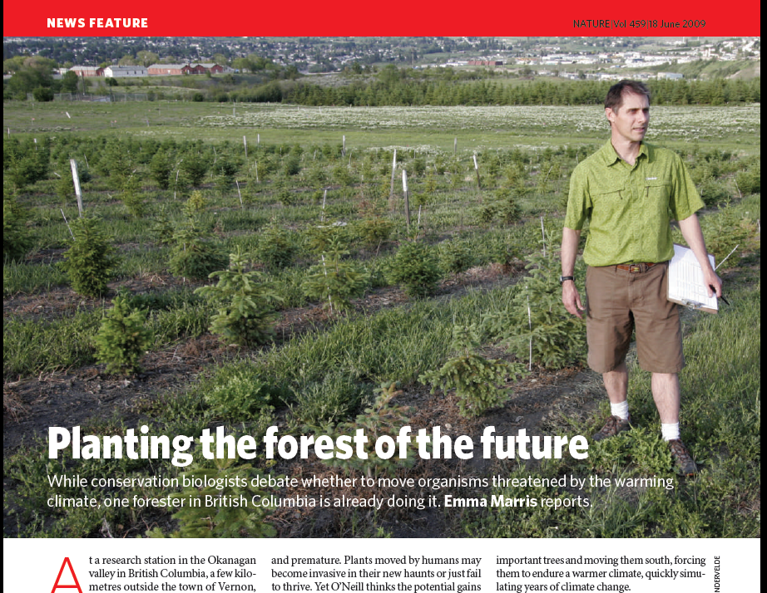
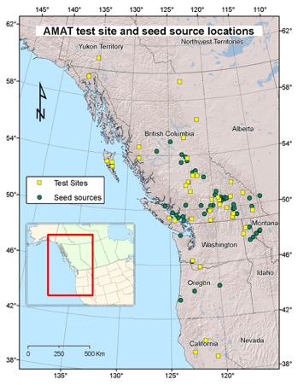
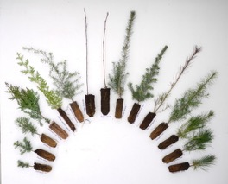
Concept of assisted migration
We can adapt our forests for the future by ENRICHING their genetic (provenance) and specific (new species) composition.

Slide 27

As for investments, we can intelligently DIVERSIFY the species of trees in our forest to reduce the risks.

Slide 28
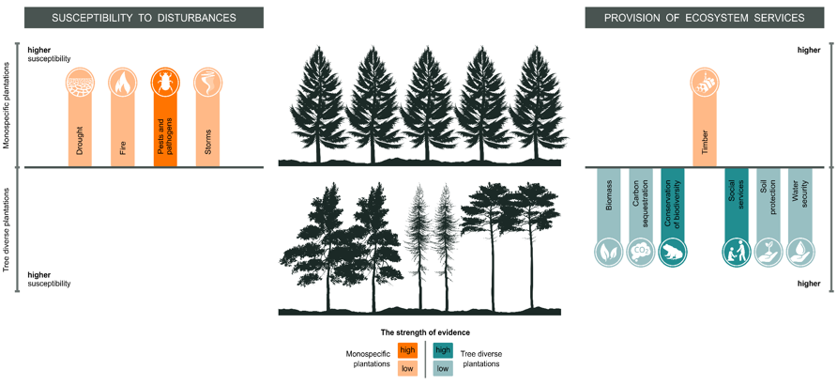
By diversifying our plantations, we reduce susceptibility to disturbances and increase the production of ecosystem services
Notes:
Susceptibility to some main forest disturbance of monospecific (top) and tree diverse plantations (bottom). Bars are individual disturbances and direction of the bars (top vs bottom) indicates higher susceptibility to disturbances between these two types of planted forest.
Colour intensities of bars represents the strength of evidence (high or low certainty).

Slide 29

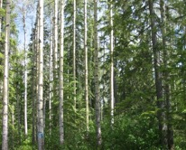
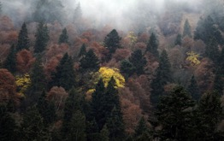
The effect of tree species diversity on productivity

Slide 30
By diversifying the forest landscape, the risks are reduced

Slide 31
  OK, but how do we apply it in the field?

Slide 32
Presentation Plan
  Forestry and its ghosts
  The threatened forest
  Some interesting new concepts
  For a forestry of resilience

Slide 33
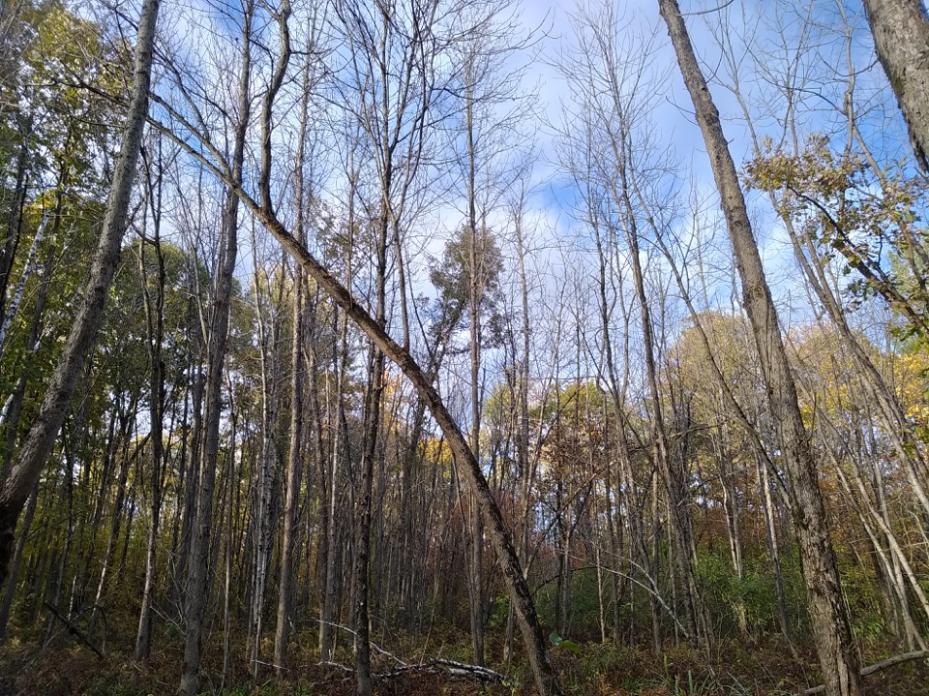
What is resilience?
The ability of a system to withstand, rapidly recover from, or adapt to one or more disturbances or stresses so that the system retains its structure and functions. (adapted from Gunderson & Holling 2002).

Slide 34
  THE SOLUTION: by diversifying INTELLIGENTLY and EFFECTIVELY

Slide 35
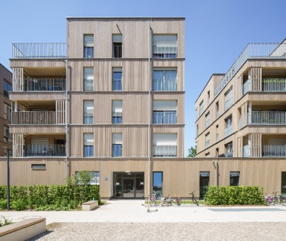
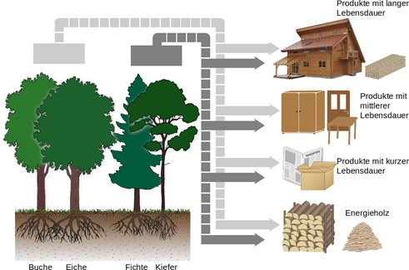
Reversing the relationship
WOOD FOREST INDUSTRY
Until now, the "wood" industry has conditioned the simplification of the forest: a typical TOP-DOWN approach
Forest
Wood industry
Holzprodukte
Home
Furniture, etc.
Paper and cardboard
Energy
Photo: Hafner

Slide 36



Reversing the relationship
WOOD INDUSTRY FOREST
In the future, the need a MORE DIVERSIFIED RESILIENT forest that will condition the "wood" industry: a typical BOTTOM-UP approach of an Adaptive Complex System
The forest
Wood Products
Forest
Wood industry
Holzprodukte
Buildings
Home
Furniture, etc.
Furniture, etc.
Paper and cardboard
Paper, Packaging
Energy
Energy
Photo: Hafner

Slide 37
Diversity and functional connectivity are promoted

Slide 38
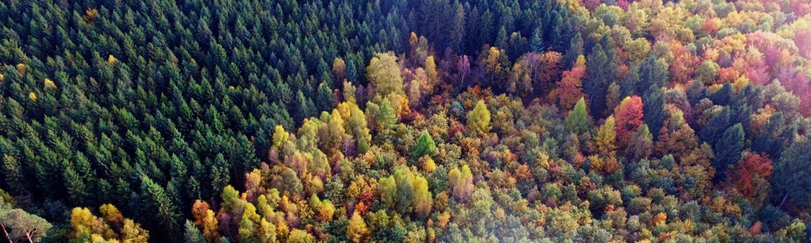
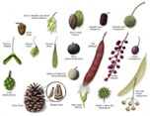





FUNCTIONAL TRAIT DIVERSITY: A better way to characterize tree diversity
FUNCTIONAL DIVERSITY: how different species act in the ecosystem and respond to disturbances
Or how different species ACT in the ecosystem and REACT to disturbances
Properties of the leaves
Dispersal method
Rooting depth
Type of mycorrhizae
Density of the wood
Bark thickness
Germination capacity

Slide 39
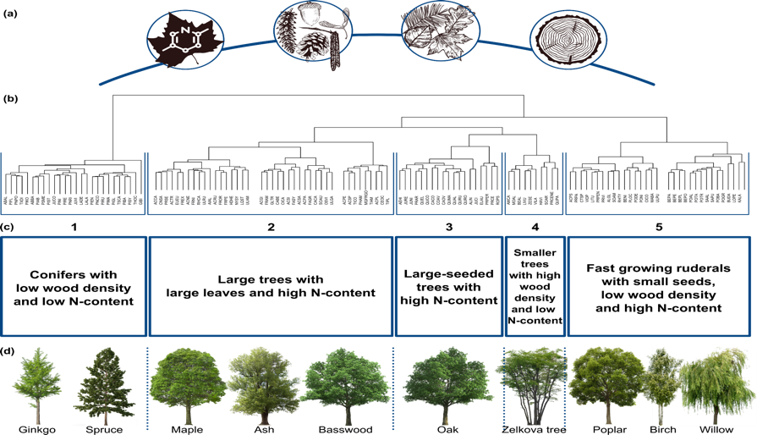
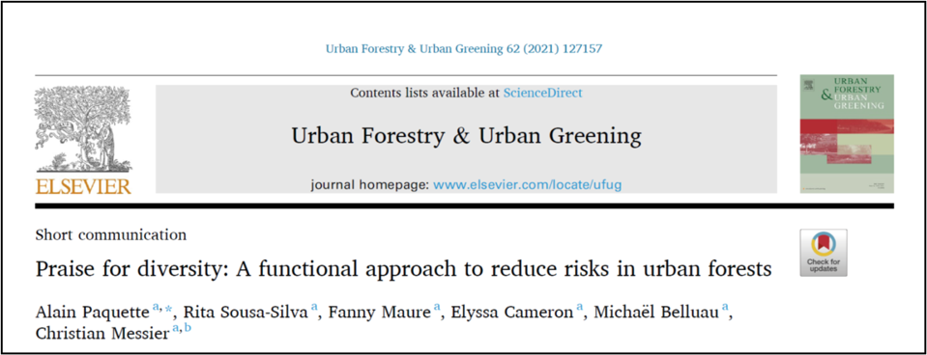
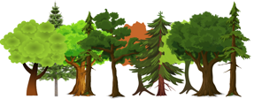
GROUPING TREE SPECIES INTO FUNCTIONAL GROUPS: to help diversify effectively
Seed dispersal
Leaf thickness
Wood density
N content
Etc.

Slide 40


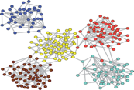

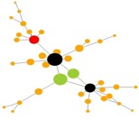


FUNCTIONAL CONNECTIVITY AND CENTRALITY: a way to optimize our intervention
FUNCTIONAL CONNECTIVITY: The potential level of exchange of tree propagules (measured in terms of functional traits that can be transferred) between stands and forest properties
CENTRALITY: The level of influence or connectivity of nodes in a network. It is used to determine the most influential nodes.
Connectivity
(4) Modularité
Centrality
PAYSAGE / RÉGION
Hub-connector
Complex network
Hub
Connector
Peripheral node
Bunn et al. 2000
Müller-Linow et al. 2008

Slide 41




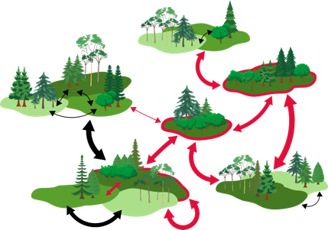







Here is an example
Before the intervention
After the intervention
Densité du bois
Teneur en N
Dispersion des graines
Épaisseur/dimension de la feuille
Etc.
Diversité Fonctionnelle = 2,7
Connectivité Fonctionnelle= 1,8
Diversité fonctionnelle
DF= 3,2
CF= 3,8
Faible
Forte
(3) On détermine les peuplements centraux ayant une faible DF
(2) On détermine les groupes fonctionnels manquant
(1) On calcule la diversité et connectivité fonctionnelle de la forêt
(4) We plant/foster the regeneration of missing functional groups
Notes:
If you are all here today, I assume that you all alrady know about the importance of the trees and that they are key component of urban landscapes

Slide 42



}
Fir
Poplar
Sugar maple
Red maple
Yellow birch
White birch
Basswood
Hemlock
Autumn cherry
White Pine
Red Oak
>80%
40 ha

Slide 43










Application: iForêt
This tool makes it possible to determine:
The functional diversity of stands
Functional connectivity between stands
The level of vulnerability of your forest/region
The level of ecosystem services
It suggests how and where to intervene to maximize resilience at the lowest cost.
Groups 2, 3 & 4
1
2
3
4
5
Densité du bois
Teneur en N
Dispersion des graines
Épaisseur/dimension de la feuille
Etc

Slide 45

2. Calculate functional connectivity and centrality to determine management priorities
1. Calculating functional diversity
5 000 ha
3. Simulate the effects of different management scenarios on functional landscape connectivity, centrality, harvesting, etc.

Slide 46

Bois-Franc region
Atlantic maritime

Slide 47











Enriched
Functional Diversity
Mixed plantations
Forestry
Connectivity fonctional
Notes:
If we take a typical fragmented landscape, we believe that combining functional traits and network analysis it is possible to represent the landscape as an ecological spatial network of forest patches with different levels of functional diversity and functional connectivity between them. With such picture it is easier to plan strategic management interventions such as mixed plantations, enrichment planting and the promotion of rare traits through silviculture so to increase overall resilience at both stand and landscape level. This is what we call the functional complex network approach, and this is what is driving our research project.

Slide 48





Assessment of functional diversity
La Mauricie National Park
Distribution of the functional diversity of forest stands
Identification of priority sectors for diversification interventions
Recommendations to promote diversification

Slide 49


Vulnerabilities to abiotic threats
La Mauricie National Park
Écarts de température
Inondations
Sécheresse
Identification of threats of greatest concern
Guide to diversification interventions
Vents
Verglas
Notes:
La sécheresse est une menace abiotique à suivre de près au PNLM pour laquelle des impacts sont déjà observé.

Slide 50


Vulnerabilities to biotic threats
La Mauricie National Park
Longicorne asiatique
Maladie corticale du hêtre
Puceron lanigère du sapin
Identification of threats of greatest concern
Guide to diversification interventions
Rouille vésiculeuse du pin blanc
Spongieuse asiatique
Notes:
Les menaces biotiques sont plus préoccupantes que les menaces abiotiques
La spongieuse asiatique et la longicorne asiatique pourraient entraîner des conséquences importantes pour ~ 10 à 77% des peuplements forestiers

Slide 51



Identification of vulnerable sectors
La Mauricie National Park
Anticipate impacts on the landscape and ecological connectivity
Prioritize interventions in the sectors :
  the least diverse
  the most vulnerable
Prioriser les interventions
Notes:
Les peuplements les plus vulnérables sont ceux ayant reçu une valeur de diversité fonctionnelle sous la médiane par type de peuplement et étant affectés à plus de 75% par au moins une menace biotique ou abiotique préoccupante,

Slide 52
A « Marshall » Plan for Quebec forests
Do not plant or promote ONLY species considered commercial today
The species present locally may not be well adapted or diversified enough to face future climatic and biotic rigors and uncertainties
THE PAST IS NO LONGER A GUARANTEE OF THE FUTURE
NO MORE PLANTING MONOCULTURES
Favour species that are diversified in terms of their functioning
Think wood and carbon, biodiversity, key species, water, mental health, resilience, stability, etc.
1+1 = 3 OR EVEN 5: OUR BEST ALLY...DIVERSITY
We must think globally and act locally

Slide 53

Thank you!

