Slide 1
Scientific opinion on the recommendations for tapping in Quebec to ensure the sustainability of maple production
Christian Messier, Ph. D., Ing. F., Gauthier Lapa, Ph. D. et Élise Bouchard, M. Sc., Ing. F.

Slide 2
This report aims to provide an overview of the scientific knowledge on the following aspects:
The medium- and long-term sustainability of maple syrup production in Quebec in the context of global change.
The effects of repeated tapping on the compartmentalization, health and vigour of maple trees.
The effects of different tapping techniques and of the material and equipment used on the health and vigor of maple trees.

Slide 3
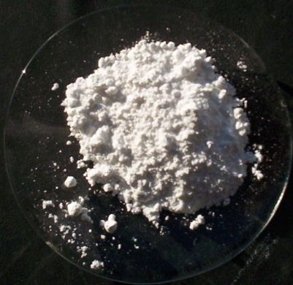
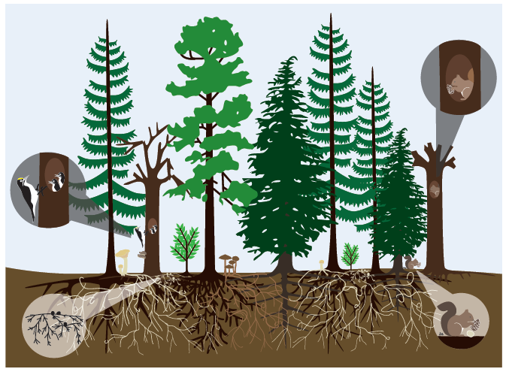
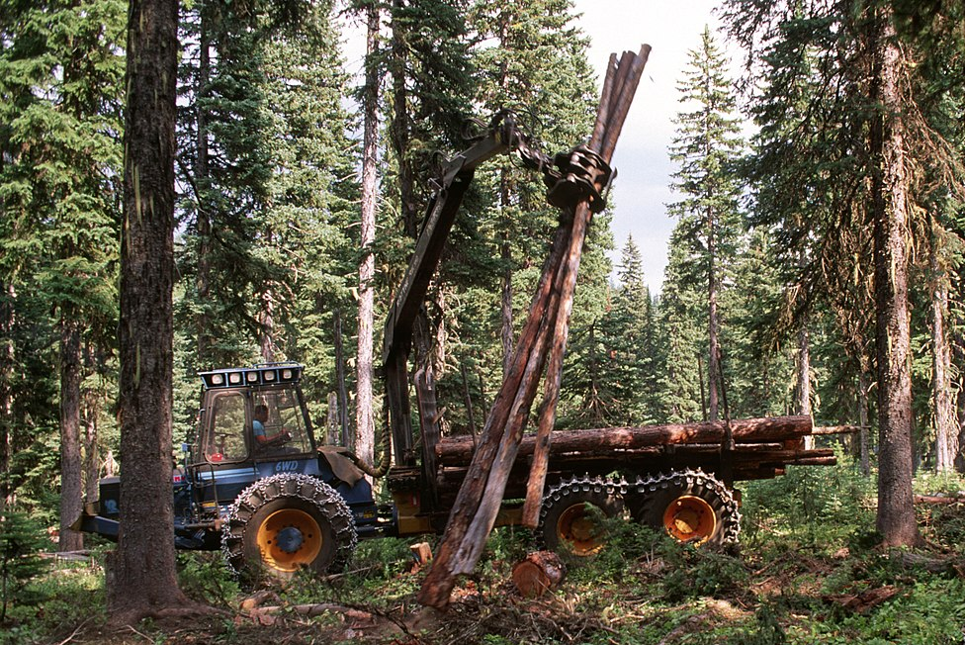
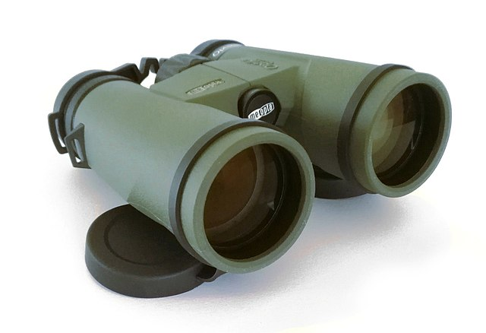

Major long-term biological and climate threats and interventions to reduce their negative impacts
Acid Rain
Climate
Extremes
Droughts
Insects and diseases
Ice
Winds
Excessive grazing
Threats
Possible interventions
Liming
Forest diversity
Thinning
Surveillance
Population
management

Slide 4
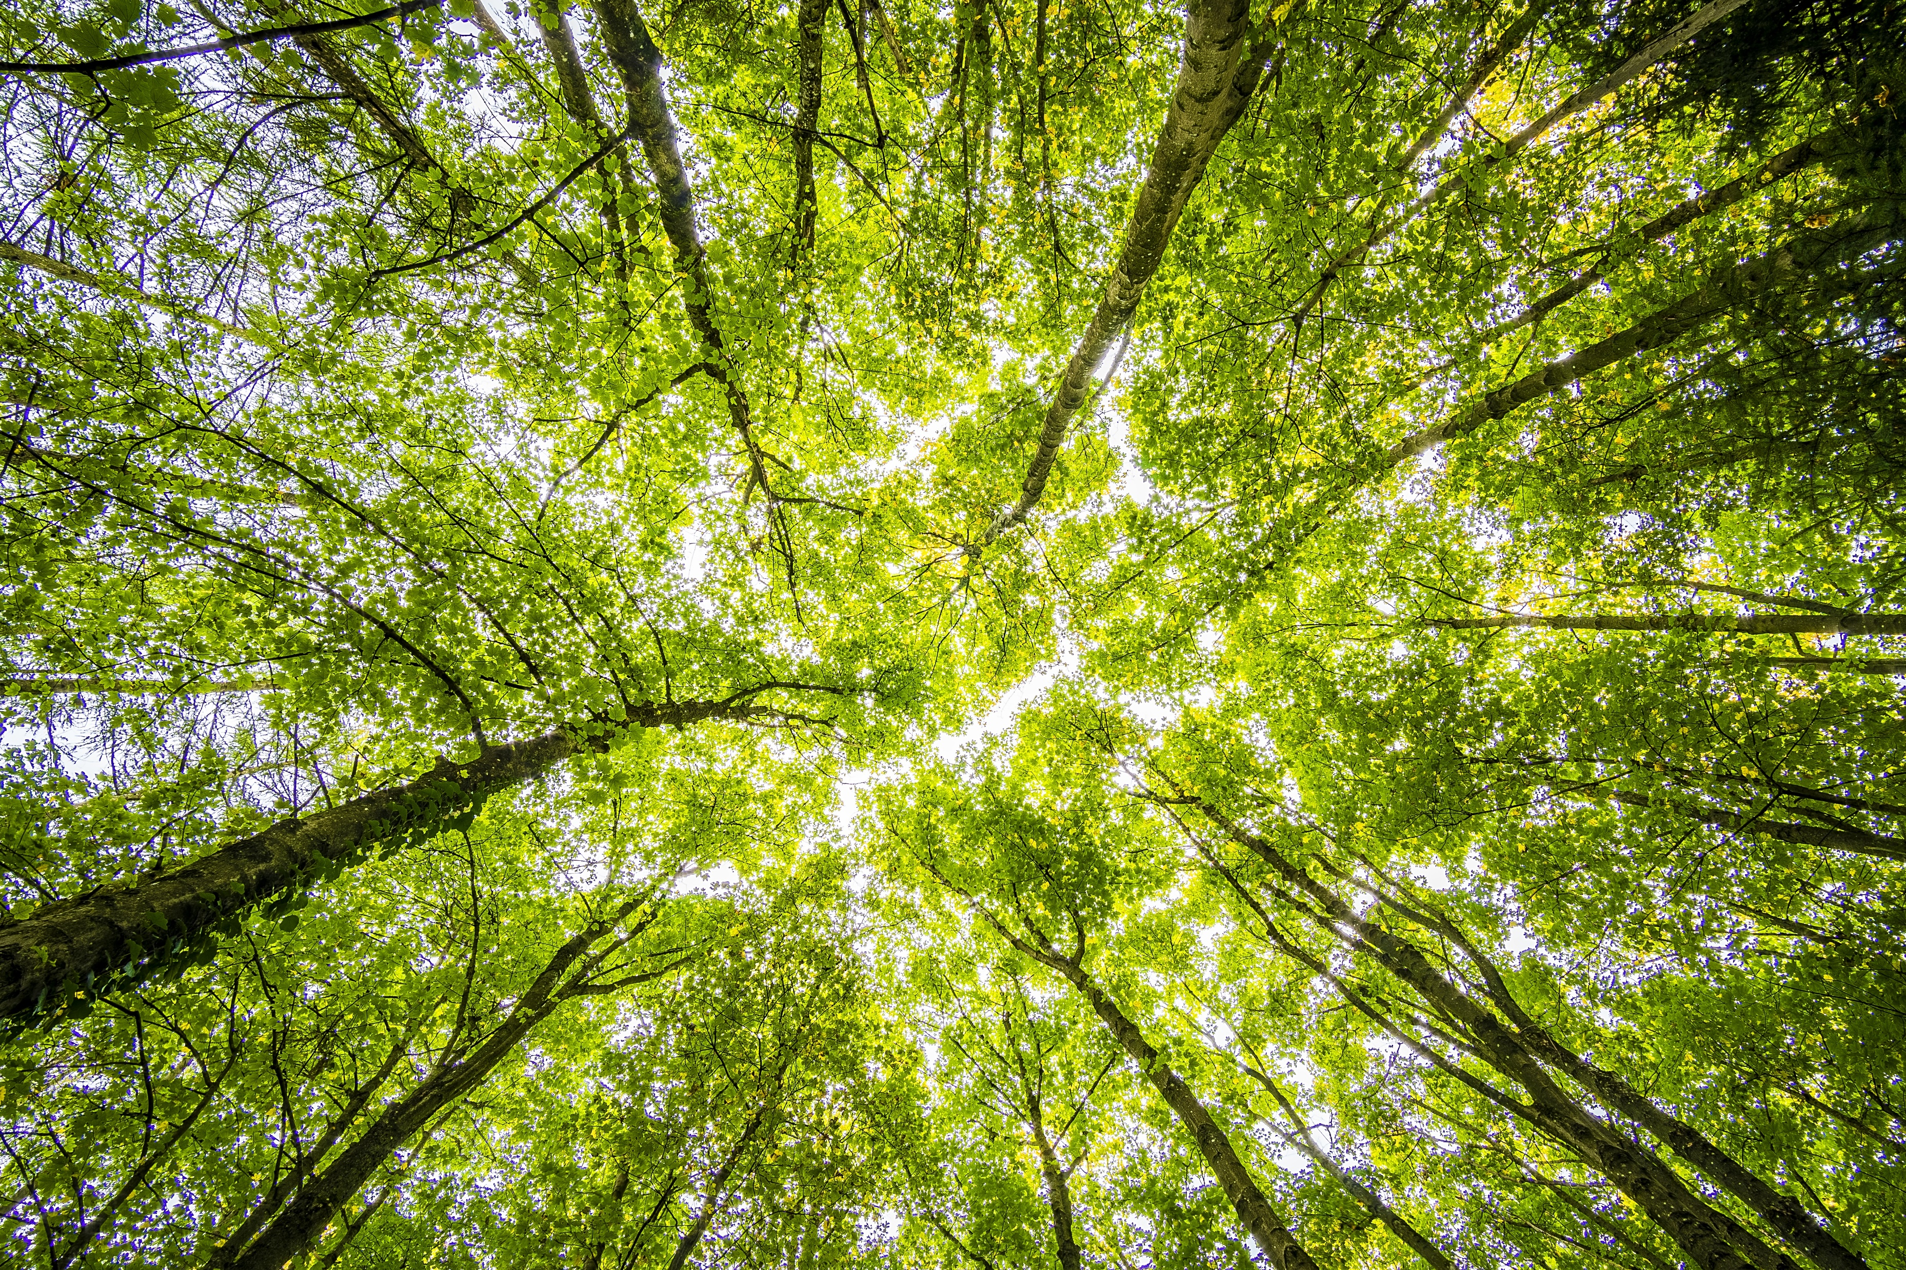

What is a healthy maple?
Less than 10% dieback in its crown
Full crown and little competition from dominants or codominants
No defoliation or major branch loss in the last 2 years

Slide 5
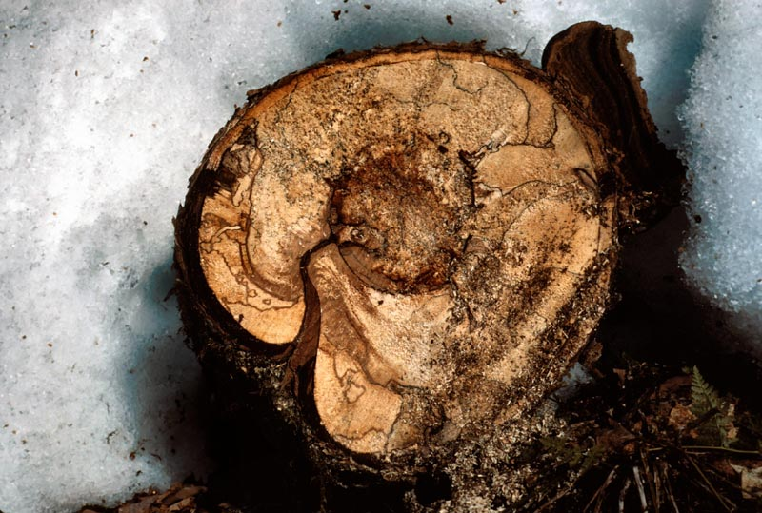

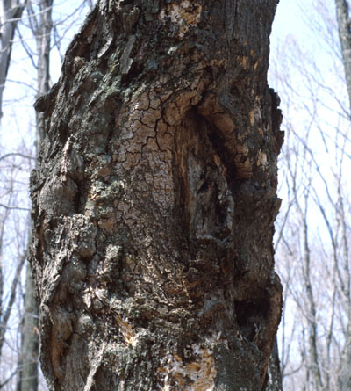
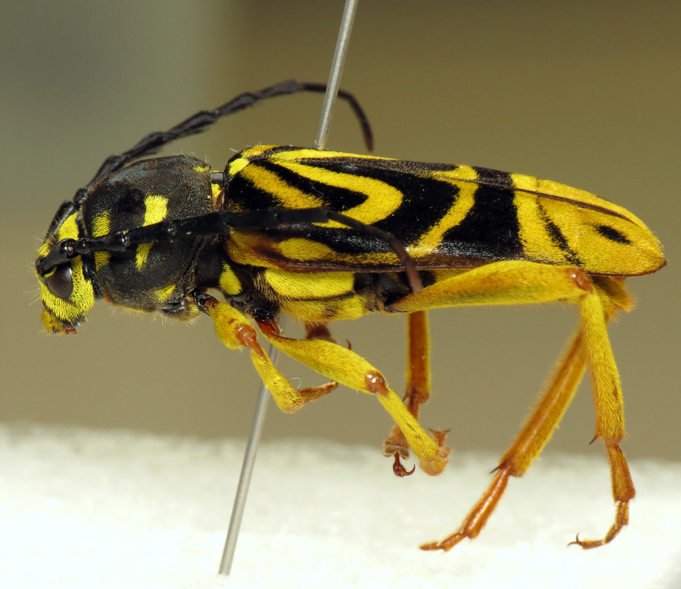

What is a healthy maple?
No or few signs of stress caused by insects and/or diseases
Healthy trunk with no major defects or injuries
No signs of internal rot
André Carpentier, RNCAN
Maple drill

Slide 6
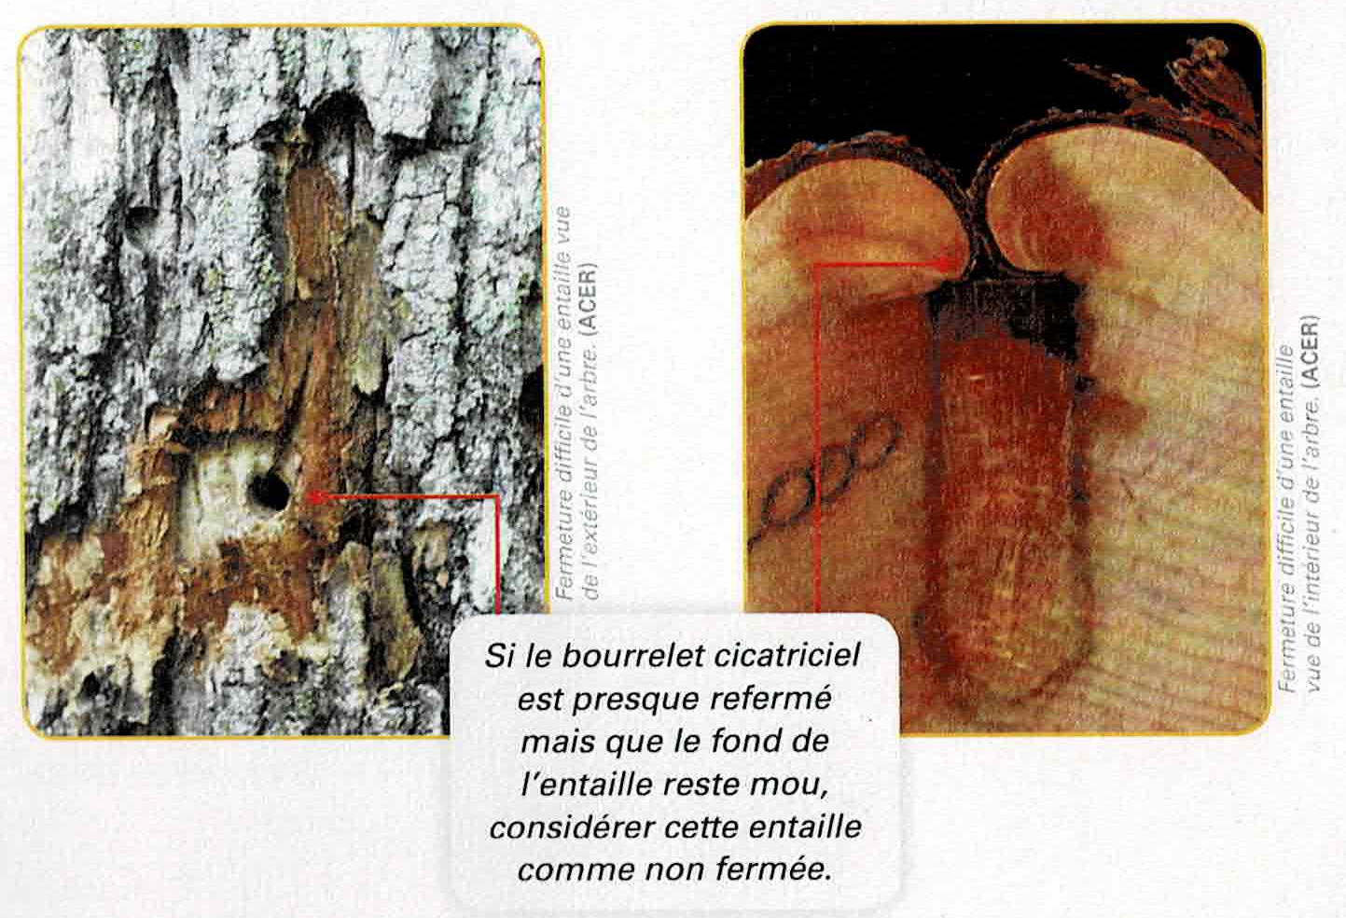
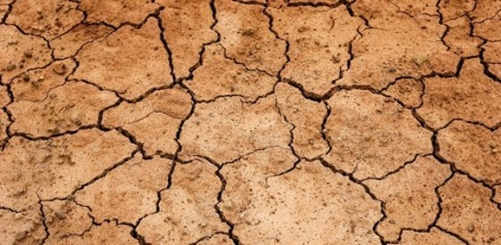
What is a healthy maple?
Rapid notch closure (2 years or less)
No significant drought in the last 2 years
Annecou et al., 2012

Slide 7
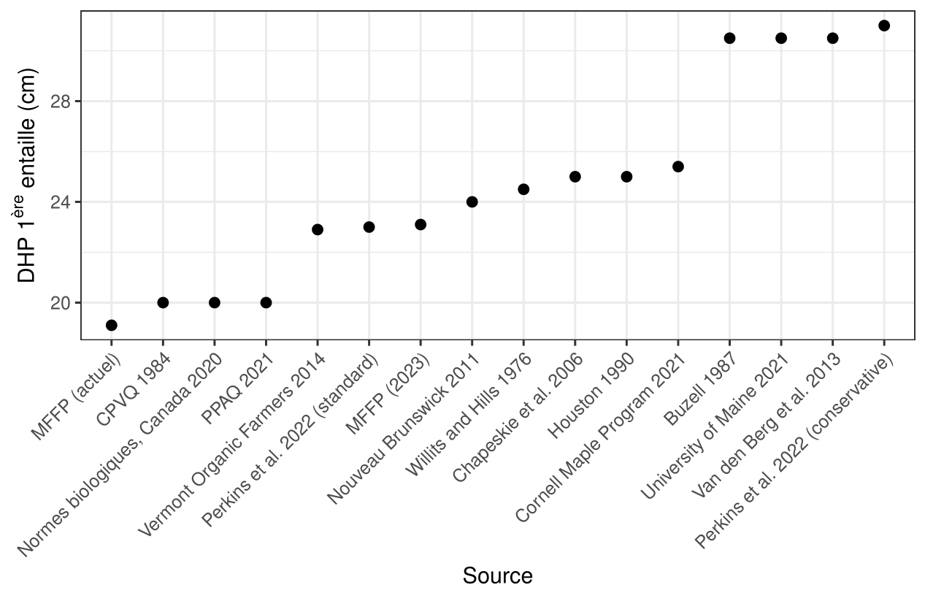
Comparison of regulations and recommendations by different organizations here and elsewhere
DHP 1st tapping (cm)
MFFP (actuel)
MFFP (proposé 2023)

Slide 8
Are the tapping standards sustainable?

Slide 9

Model developed by M. Pelletier
Variables
DHP tapping
(standard)
Depth of the tap
Thickness of wood over the first tap when returning to tap over it
Model
Diametre of the spout
Growth of the trees
Sustainable or Not sustainable

Slide 10
Model developed by M. Pelletier
Constants Conditions
Healthy tree
Trunk = a perfect cylinder
100 cm drop
Tapping above and below the lateral
Spouts distributed randomly over the entire area accessible by the fall
Horizontal margin between cuts of 10 cm
Vertical margin between 60 cm taps

Slide 11
Radial growth of sugar maples in Quebec
Sous-région écologique | Région correspondante | Croissance radiale moyenne (mm/an)
1a-T | Plaine du bas Outaouais et de l´archipel de Montréal | 1,46
2b-T | Plaines du Saint-Laurent | 0,97
2c-T | Coteaux de l´Estrie | 1,39
3c-T | Hautes collines de Val-David-Lac Mékinac | 0,79
3d-M | Coteaux de la rivière Chaudière | 1,32
3d-S | Collines du Mont Mégantic | 1,27
3d-T | Coteaux du Lac-Etchemin | 1,42
4f-M | Collines du Témiscouata | 1,56
4f-S | Collines du Lac Humqui | 1,86
4f-T | Collines et coteaux du Lac Pohénégamook | 1,39
Average radial growth of sugar maples in Quebec :
1.34 mm/year
Source : Grenier et al., 2008

Slide 12
Results of simulations M. Pelletier
Average radial growth of sugar maples in Quebec :
1.34 mm/year
Standard | Radial growth
 | 2 mm/an | 1 mm/an | 0,5 mm/an
MFFP actuel, chalumeaux 5/16", entailles de 50 mm | Sustainable | Not sustainable | Not sustainable
MFFP 2023, chalumeaux 5/16", entailles de 50 mm | Sustainable | Near sustainability | Not sustainable
MFFP 2023, chalumeaux 1/4", entailles de 50 mm | Sustainable | Sustainable | Not sustainable
PPAQ, chalumeaux 5/16", entailles de 50 mm | Sustainable | Not sustainable | NNot sustainable
PPAQ, chalumeaux 1/4", entailles de 25 mm | Sustainable | Sustainable | Limited sustainability

Slide 13
Latest recommendations from the « North American Maple Syrup Producers Manual »
Tapping guide based on diameter, tree health and harvesting method
State of the tree’s health | Harvest method | Diametre of the spout (inches) | Depth of the tap (mm) | Min. diametre of the tree(cm) | Number of taps / tree
Conservative
Optimal | Gravity | 7/16 | 25 – 64 | 31 + | 1
Sub-optimal | Gravity or vacuum | 1/4 – 5/16 | 25 – 38 | 31 + | 1
Standard
Optimal | Gravity or vacuum | 1/4 – 5/16 | 38 – 50 | 23 – 31 | 1
 |  |  |  | 46 – 56 | 2
D'après Perkins et al., 2022

Slide 14
Summary of the main recommendations proposed in this report for sustainable maple tapping in Quebec.
Santé globale de l’arbre | Diamètre maximal du chalumeau | Profondeur maximale de l’entaillage (avec écorce) | Diamètre minimal de l’arbre à 1,3 m | Nombre d’entaille maximal par arbre à partir de 40 cm
Croissance radiale optimale (plus de 1,25 mm/an)
Bonne | 5/16" | 45-50 mm | 23,1 cm | 2
Mauvaise | 5/16" | 45-50 mm | 31 cm | 2
Mauvaise | 1/4 ou 5/16" | 45-50 mm (si chalumeau de 1/4") ou 25-30 mm (si chalumeau de 5/16") | 23,1 cm | 2
Croissance radiale sous-optimale (moins de 1,25 mm/an)
Bonne | 1/4 ou 5/16" | 45-50 mm (si chalumeau de 1/4") ou 25-30 mm (si chalumeau de 5/16") | 23,1 cm | 2
Bonne | 5/16" | 45-50 mm | 31 cm | 2
Mauvaise | 1/4" | 25-30 mm | 31 cm | 1
Croissance radiale très faible (moins de 0,50 mm/an)
Bonne ou Mauvaise | 1/4" | 25-30 mm | 31 cm | 1

Slide 15
Other important points
Pelletier's model is for perfect conditions
Recommendations consider tapping above and below the lateral
Tapping has a non-significant effect on growth
Maple seems to be able to compensate for the loss of sugar and xylem caused by tapping
A study is needed to update and specify the radial growth of maples in Quebec according to regions and sub-regions
The growth of maple trees over the last ten years should be measured locally and monitored
The effect of tapping on the compartmentalized zone is crucial and studies are rare
At least 20% of companion species should be retained, mostly other than red maple

Slide 16
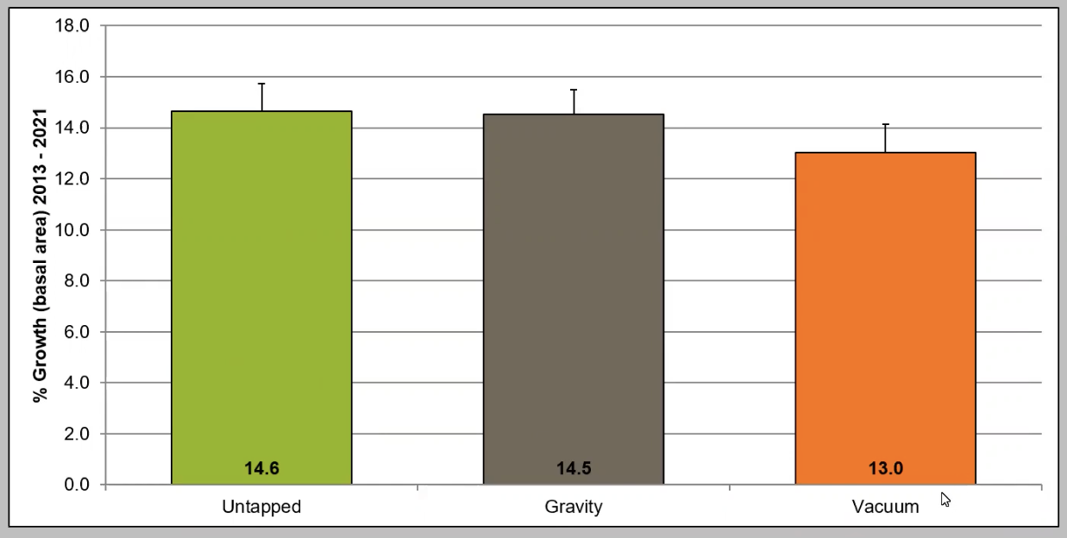
How does tapping impact the radial growth of maples?
No significant differences
Control
Gravity
Vacuum
Source : communication de Abby van den Berg, U. Vermont

Slide 17
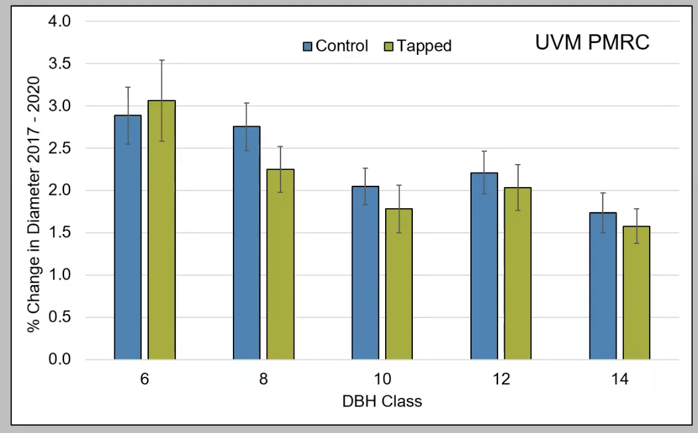
Long-term impacts of tapping on radial growth of maples
Control
Tapped
No significant differences
Source : communication de Abby van den Berg, U. Vermont

Slide 18
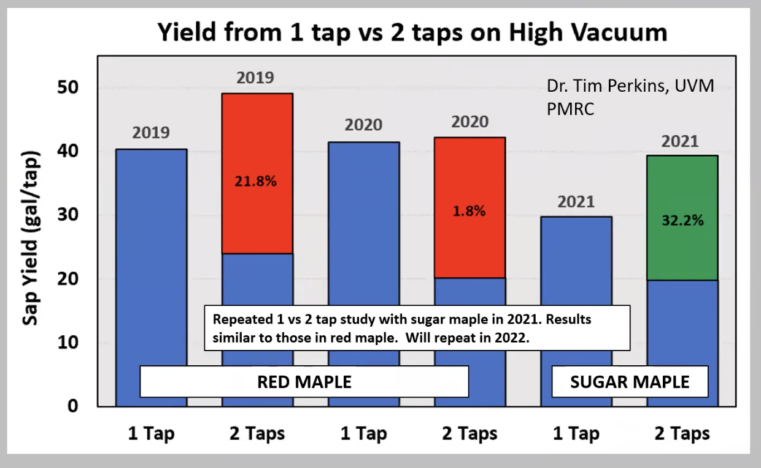
Effects of tapping practices on yield
1 vs. 2 taps with high vacuum
2^{ième} entaille
The yield can increase with the number of taps per tree, but :
Not always and it does not double
Higher vacuum and lower dbh reduces the gain
1er entaille
Source : communication de Abby van den Berg, U. Vermont

Slide 19
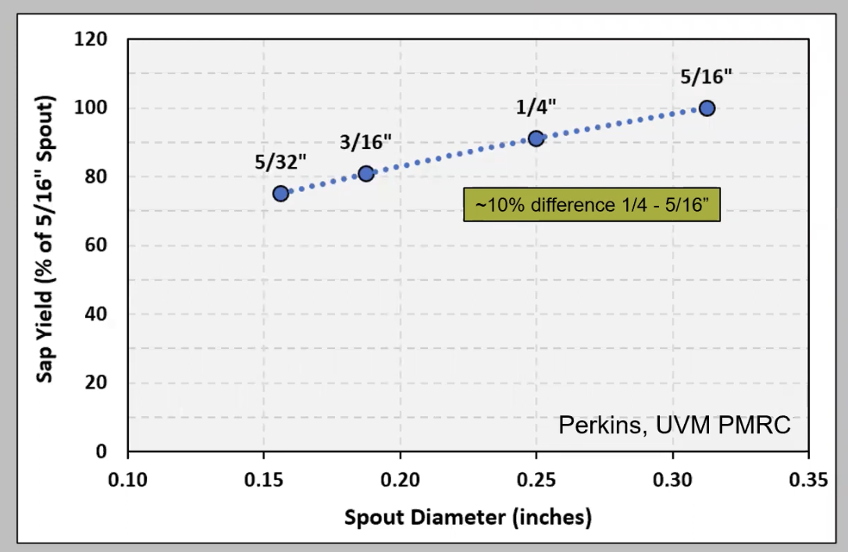
Effects of tapping practices on yield
Effects of the spout diametre
The output increases with the diameter of the spout
Source : communication de Abby van den Berg, U. Vermont

Slide 20
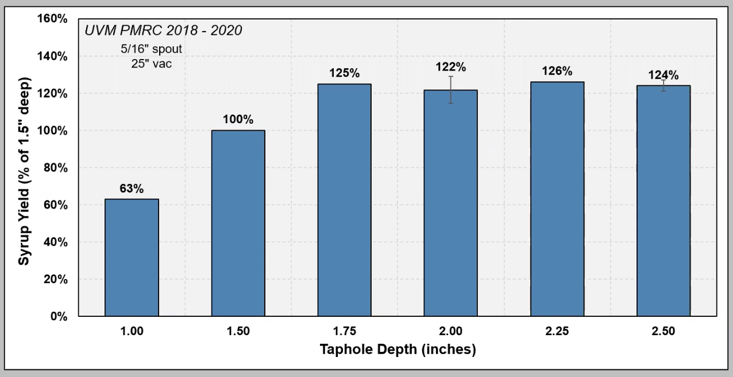
Effects of tapping practices on yield
Effects of the depth of the taphole depth
44,45 mm
Deeper cuts increase yield, up to a threshold
Source : communication de Abby van den Berg, U. Vermont

Slide 21
Priority of knowledge acquisition
  Effects of tapping on maple growth,
  Effects of new tapping techniques on the amount of water collected
  Effects of new tapping techniques on the spatial distribution of compartmentalization in the sapwood of maple and the causes of this high variability
  The dynamics of reserves in maple trees in spring and its effects on the long-term growth of maple trees
  The loss of hydraulic conductivity of the tree caused by the compartmentalization of the sapwood following tapping, particularly following a dry summer
  The resilience of maples to various stresses such as dry summers, winters with significant thawing and significant defoliation during the summer, considering the decrease in reserves and the proportion of conductive xylem
  Importance of companion species for maple health and management to increase the resilience of maple stands to global changes

Slide 22
Thank you!

